Slide 1


A.S.L.P Presentation
Abdelrahman Hassan Gabry – AI Model Developer Abdelrahman Mostafa – API Developer & Team Leader Hamza Mohamed – Flutter Mobile Application Developer Hazem Yasser – Flutter Windows Software Developer

Slide 2
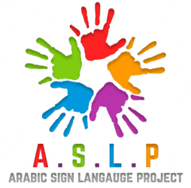

Slide 6
Introduction
Our project is designed to empower individuals with speech and hearing impairments by enabling seamless communication through mobile and desktop applications.
Using AI technology and an API to integrate the desktop & mobile applications, our system detects and interprets sign language, converting gestures into text and speech while also translating text into sign language.

Slide 7




Potential Uses
- Government agencies & hospitals
- Public places (ex. Screen in Malls)
- Robot in restaurants
- Easily accessible mobile & desktop application

Slide 8
Project Objectives
Real-Time Sign Recognition
Gesture Classification
User Authentication
Text-to-Sign Language Conversion
History and Progress Tracking
User-Friendly Interface

Slide 9
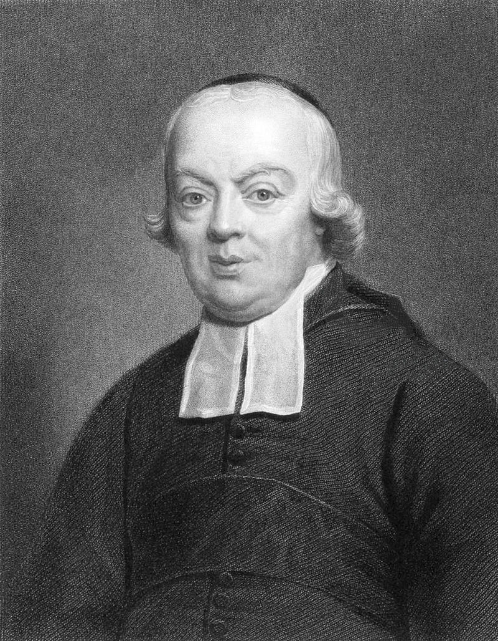
Beginning of Sign language
Charles-Michel de l'Épée, a French priest, founded the first public school for the deaf in the 1760s and helped lay the foundation for modern sign languages, including French Sign Language (LSF), which influenced ASL and others. Over time, different regions developed their own sign languages shaped by local deaf communities and cultures.

Slide 10
Mini-Block Diagram
Mobile Application
API
AI Models
Desktop Application

Slide 11
AI Introduction
Our ASL recognition system utilizes Artificial Intelligence (AI) and Deep Learning to accurately detect and classify Arabic Sign Language gestures. We have developed two advanced models

Slide 12
Used Algorithms
MobileNetV2:
95% Accuracy all letters working
Approach: MobileNetV2 was used due to its lightweight nature, making it ideal for mobile and embedded applications.
Pros:
Lightweight, with a small number of parameters suitable for mobile devices.
Fast inference and low power consumption.
Good accuracy while maintaining a reasonable model size.
Results: MobileNetV2 provided a good balance of accuracy (95%) and model size (much smaller than CNN), making it suitable for real-time classification on mobile platforms.
LSTM (Long Short-Term Memory)
Pros:
Suitable for time series prediction and sequential data.
Effective at capturing short-term dependencies in sequences.
Cons:
Struggles with long-range dependencies and large datasets.
Not as efficient for large-scale data or long sequences.
Challenges in Our Project: The LSTM model performed poorly on our data due to the high similarity of the sequences, which made it less effective in differentiating subtle gestures.

Slide 13
Used Algorithms
2.2 Transformer Model
Why Transformer?
Transformers excel in handling long-range dependencies, allowing the model to attend to the entire sequence context.
Unlike LSTMs, Transformers can process sequences in parallel, leading to faster training and inference times.
Pros:
Handles long sequences well and provides better accuracy on complex datasets.
Faster training and more efficient use of computational resources due to parallel processing.
Provides better interpretability with attention maps.
Performance: The Transformer-based model significantly improved performance compared to LSTM, providing more accurate results for gesture recognition.

Slide 14
Failed Algorithms
Random forest:
100% Accuracy, 0 Letters work
Pros:
Simple to implement and train quickly.
Less prone to overfitting than a single decision tree.
Good for noisy or unbalanced data.
Cons:
Struggles with high-dimensional data.
Not as accurate as boosting methods for many datasets.
Accuracy 100% (overfitted)
XGboost:
80% accuracy, 6 Letters working
Pros:
Highly accurate and efficient for complex datasets.
Handles missing values and includes regularization to reduce overfitting.
Cons:
Slower training, especially on large datasets.
Requires significant hyperparameter tuning.
Accuracy 90% (Not good in real time classification)

Slide 15
Failed Algorithms
SVM:
90% Accuracy, 13 Letters working
Pros:
Highly accurate on small to medium-sized datasets.
Handles high-dimensional spaces well and uses kernel tricks for non-linear data.
Cons:
Slow training on large datasets and requires feature scaling.
Accuracy 89%(The best one in real time classification)

Slide 16
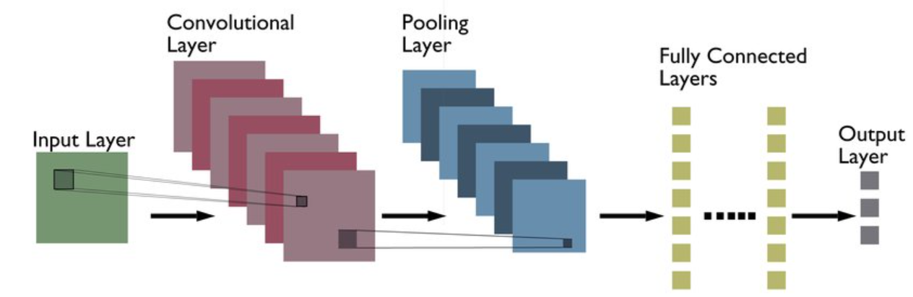
CNN-Based Model (MobileNetV2 with Data Augmentation)
This model is designed for efficient and lightweight image-based sign recognition.
We use MobileNetV2, a convolutional neural network

Slide 17
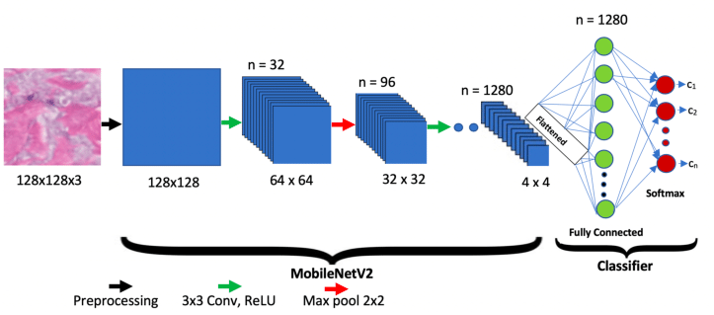
CNN-Based Model (MobileNetV2 with Data Augmentation)
optimized for speed and accuracy. To improve generalization and robustness, we apply data augmentation techniques such as rotation, flipping, and brightness adjustment.
This ensures the model can handle variations in lighting, hand positions, and backgrounds, making it more adaptable to real-world scenarios.

Slide 18
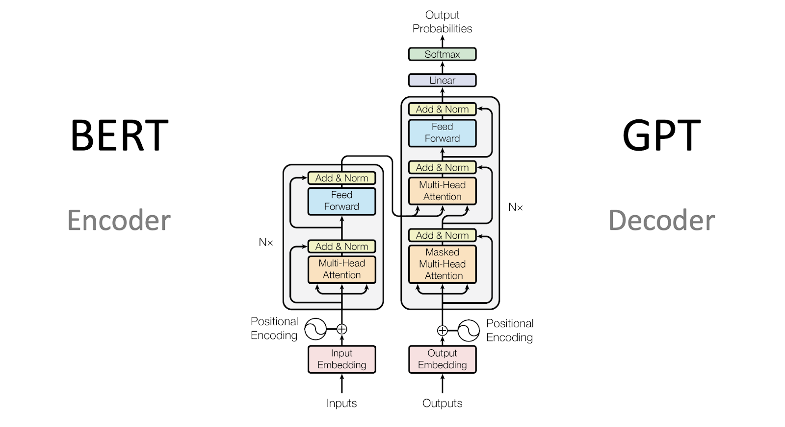
Transformer-Based Model
To enhance performance and context understanding, we implement a transformer-based model for sign language recognition.
Unlike CNNs, which process spatial features, transformers leverage self-attention mechanisms to capture temporal and spatial relationships in sign gestures.
This allows the model to recognize complex hand movements more effectively, improving accuracy in real-time gesture classification.

Slide 19
Flask API
Our Flask-based API serves as the backbone of the project, enabling seamless communication between the AI model, mobile (Flutter) app, and desktop application.
It facilitates real-time processing and ensures real-time interaction and smooth integration with AI models for accurate sign language detection and interpreting.
Built with Flask, chosen for its lightweight, scalable, and modular design.
Uses SQLite3 for structured data storage and retrieval.

Slide 20
API Key Functions
User Authentication & Management:
Secure registration, login, and data protection.
Sign Language Processing: Receives video input, sends it to the AI model, and returns recognized text or speech.
Text-to-Sign Conversion:
Processes text input and triggers corresponding sign language animations.
Learning Progress Tracking:
Logs users’ sign language learning attempts and success rates.
History Management:
Stores user activity records with the ability to delete or reset history.

Slide 21
API Technology & Efficiency
Built with Flask, chosen for its lightweight, scalable, and modular design.
Uses SQLite3 for structured data storage and retrieval.
Ensures real-time interaction and smooth integration with AI models for accurate sign language detection and translation.

Slide 22
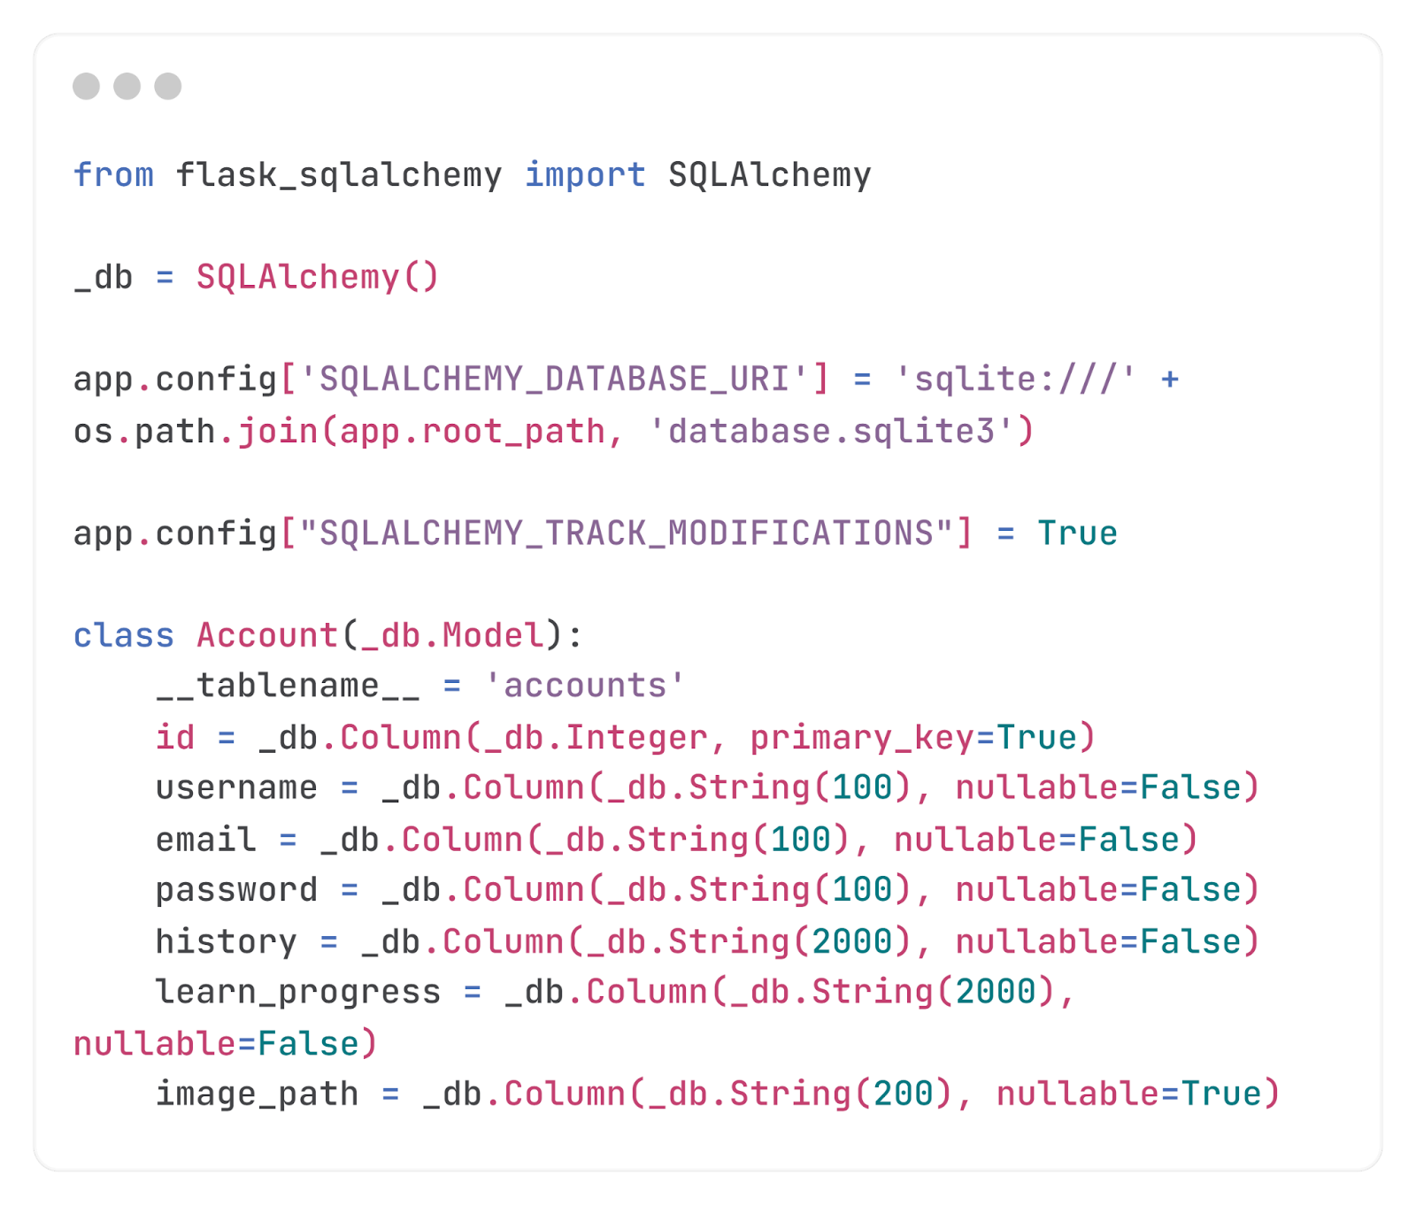
Database Creation
Initializes the database and creates the template of account

Slide 23
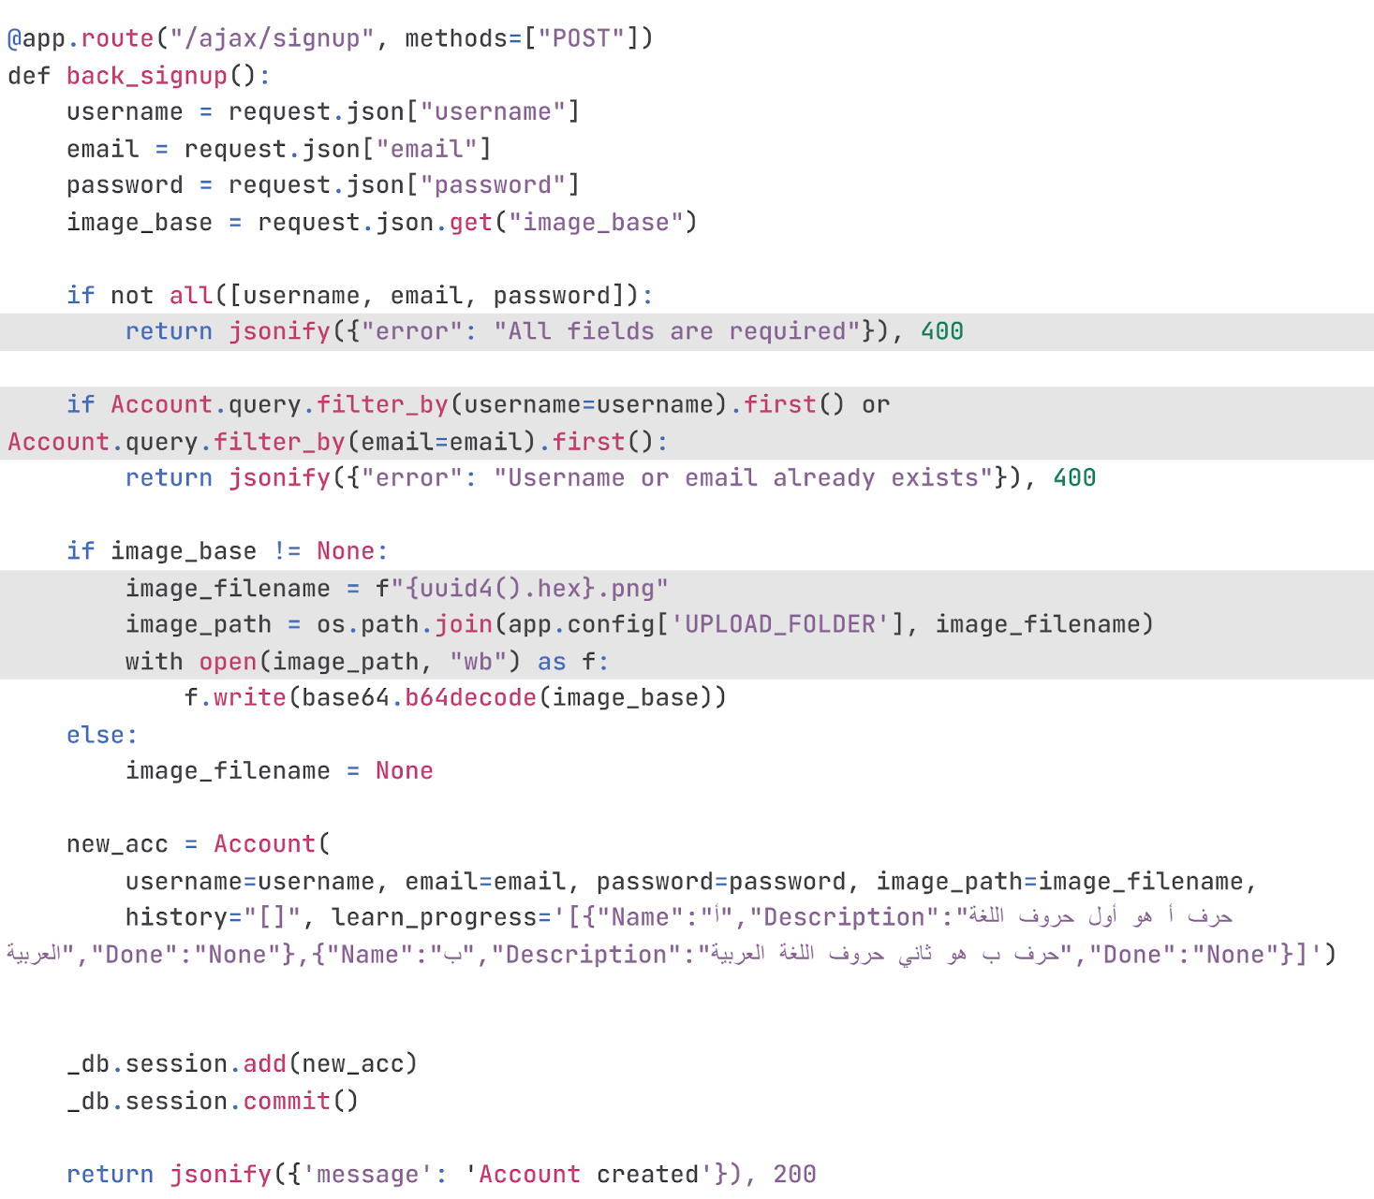
Account Creation
Handles the creation of new accounts to the database

Slide 24
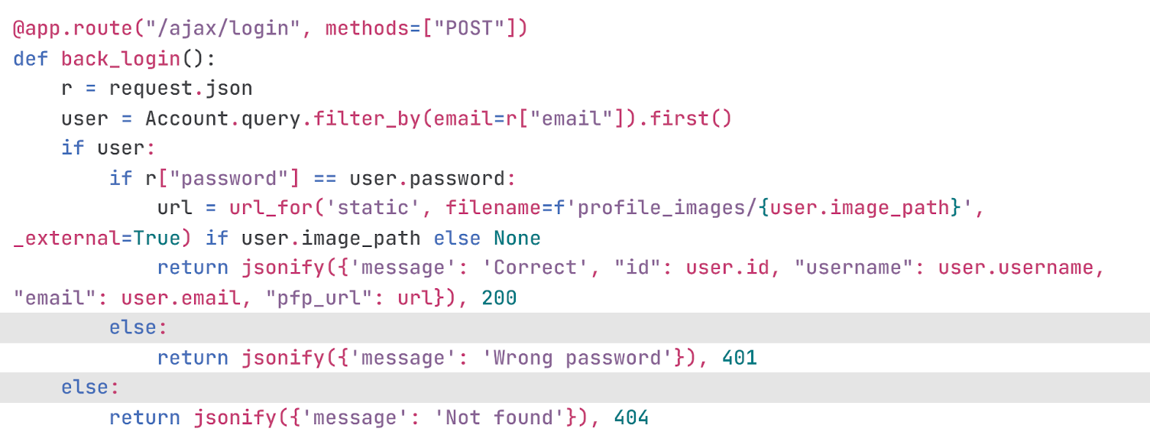
Account Login
Handles logging in and the authentication of password and username

Slide 25
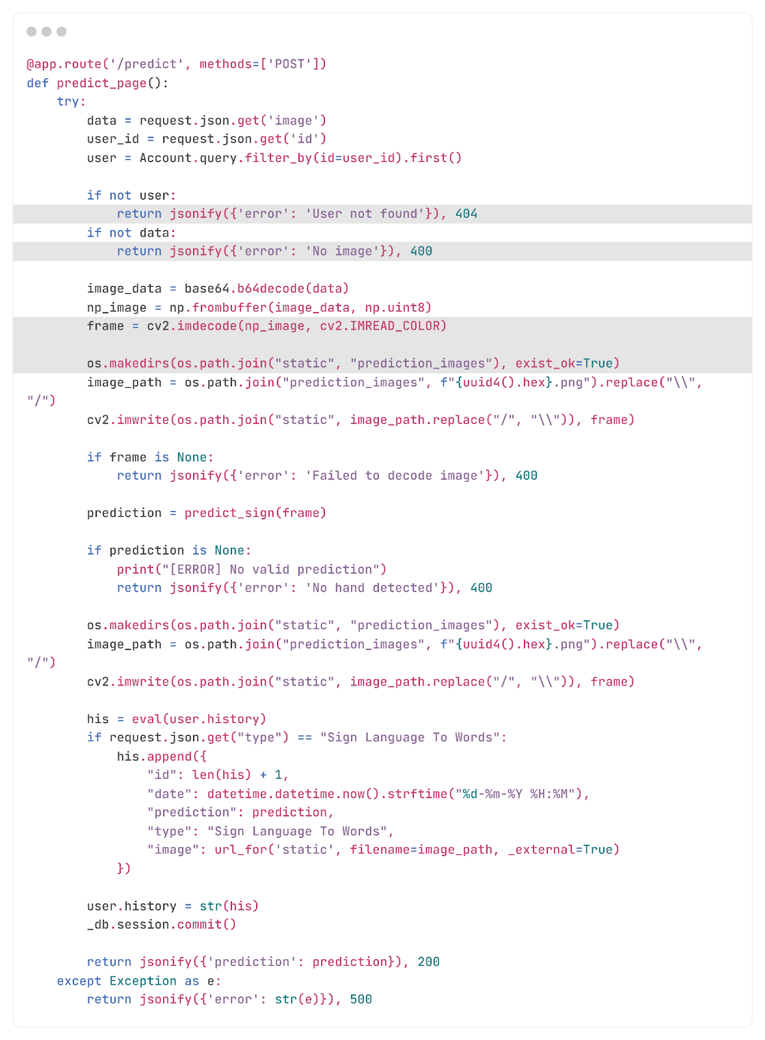
Image Predict
Processes received image, adds prediction to user’s history and returns prediction

Slide 26
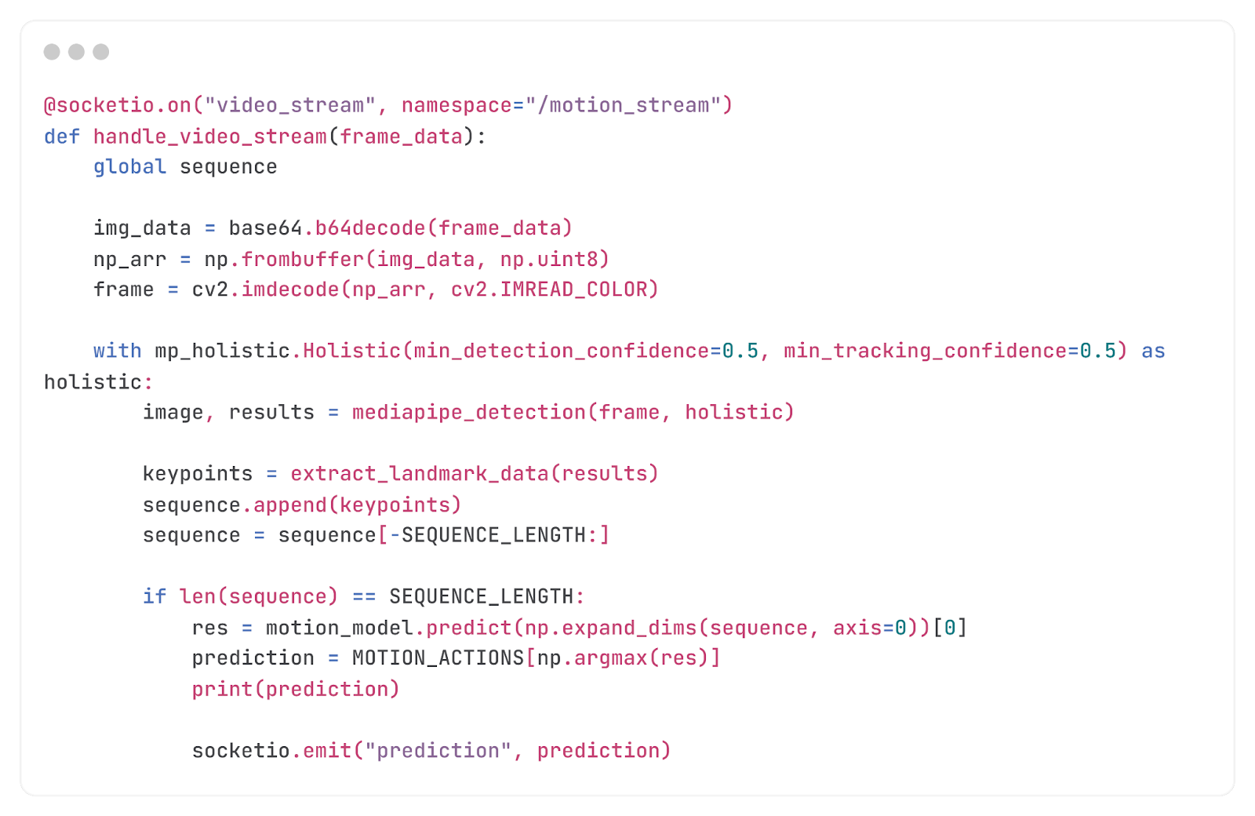
Video Stream
Using the library socket-io, the endpoint opens a video stream between the server and the applications, the server listens for frames sent from live stream and process the frames through the motion prediction AI model and sends the prediction back to the applications, this loop continues until the connection is closed then adds prediction to user’s history

Slide 27
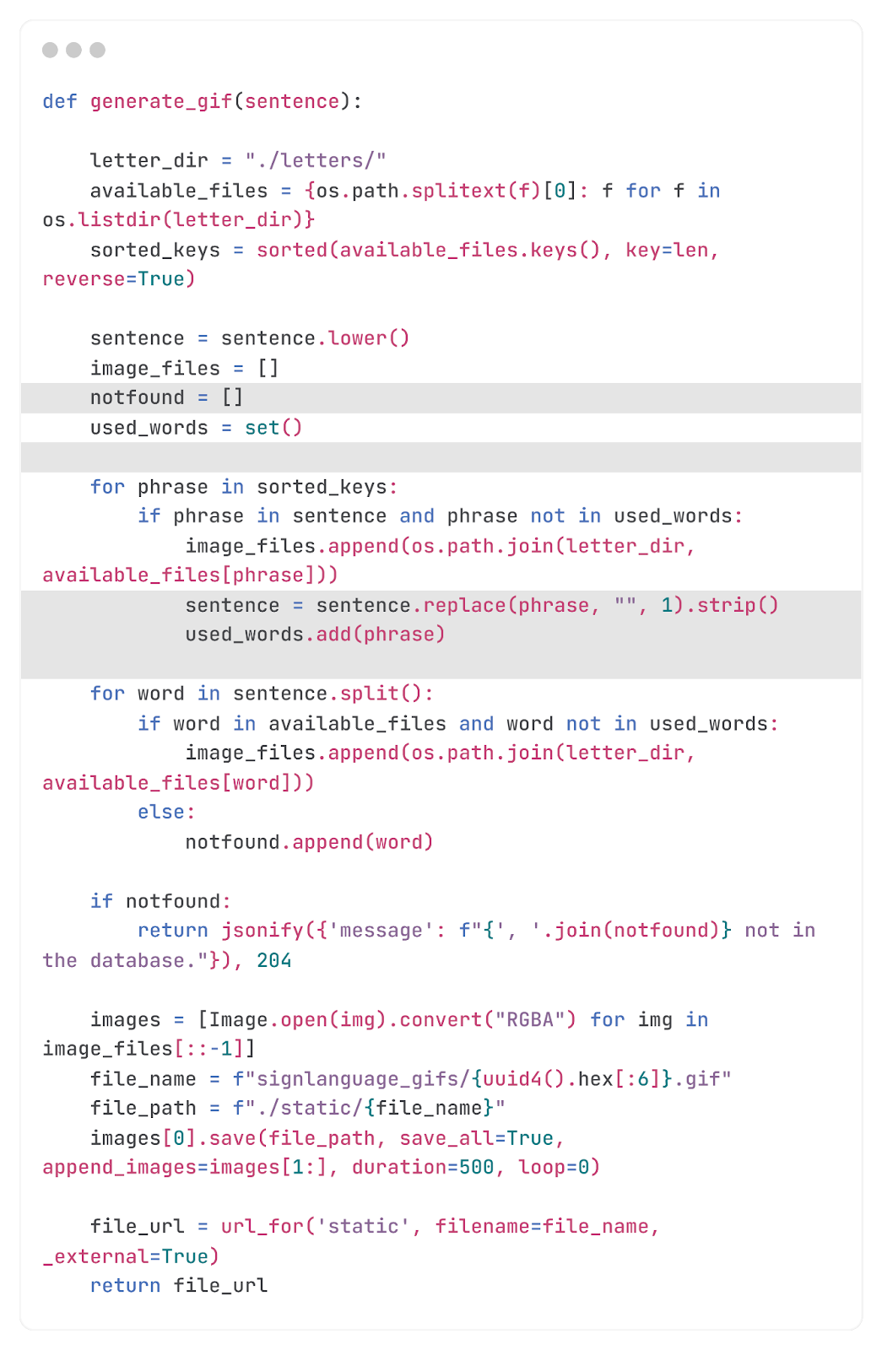
Generate GIF
Function that gathers saved images in a folder and makes a gif

Slide 28
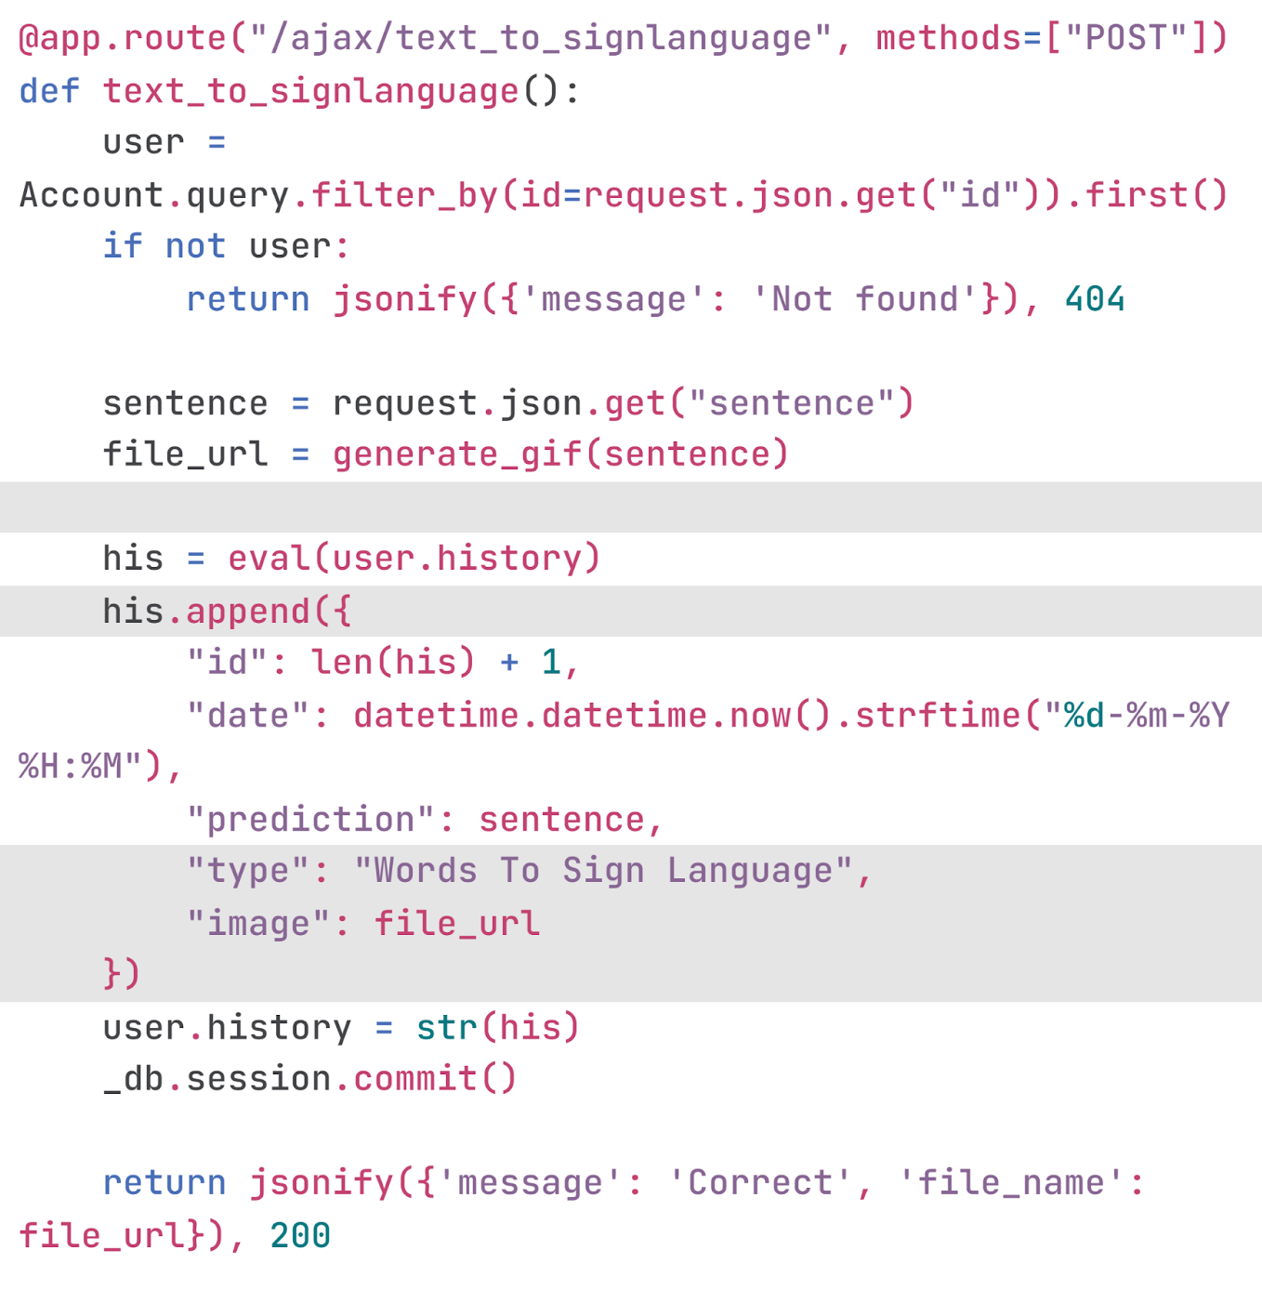
Text to Sign Language
The endpoint calls the generate_gif function to generate a gif of the words from images in a folder

Slide 29
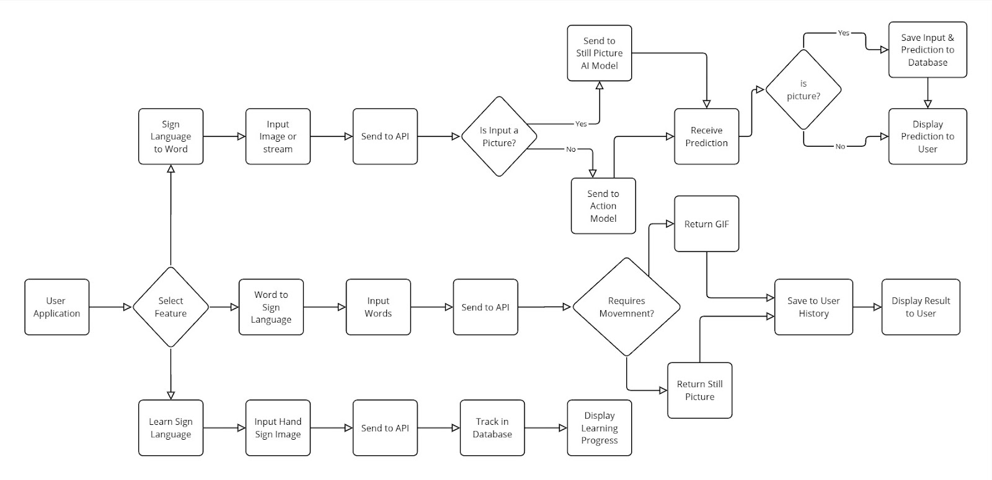
Full-Block Diagram

Slide 30
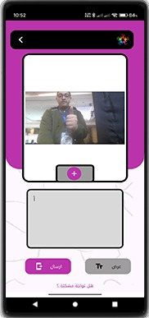
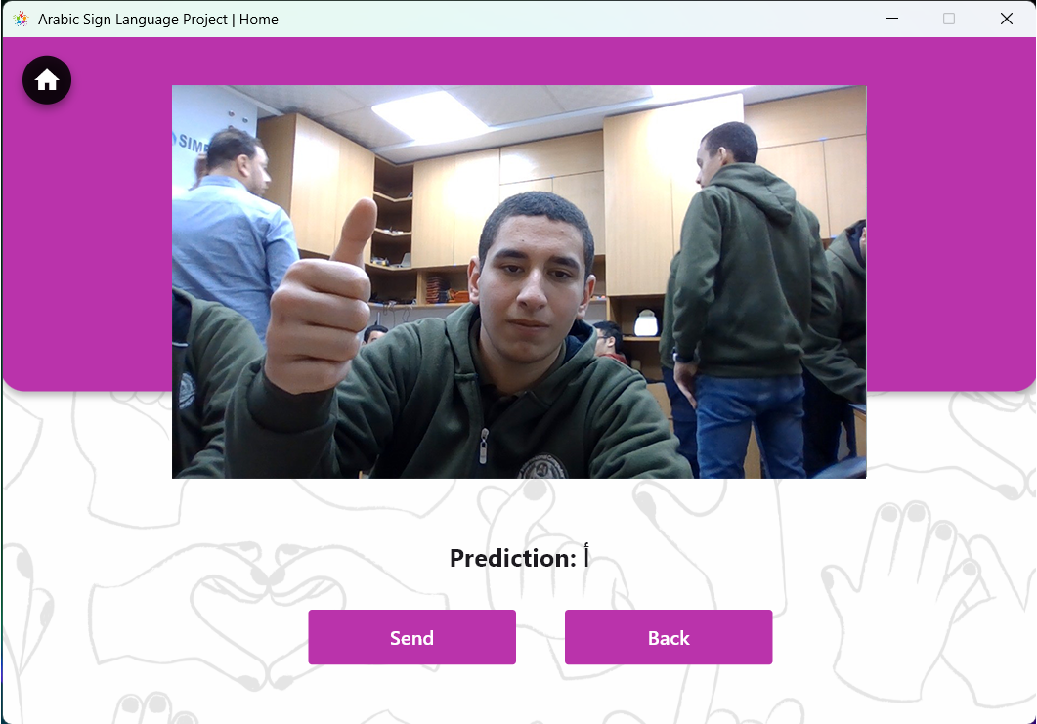
Overview of Sign Language to word

Slide 31
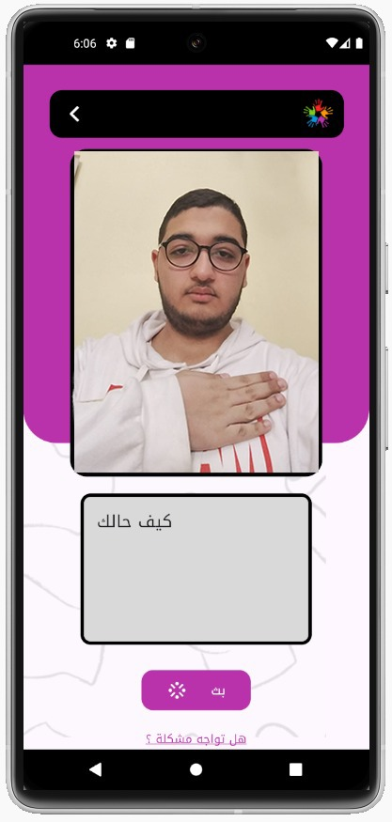
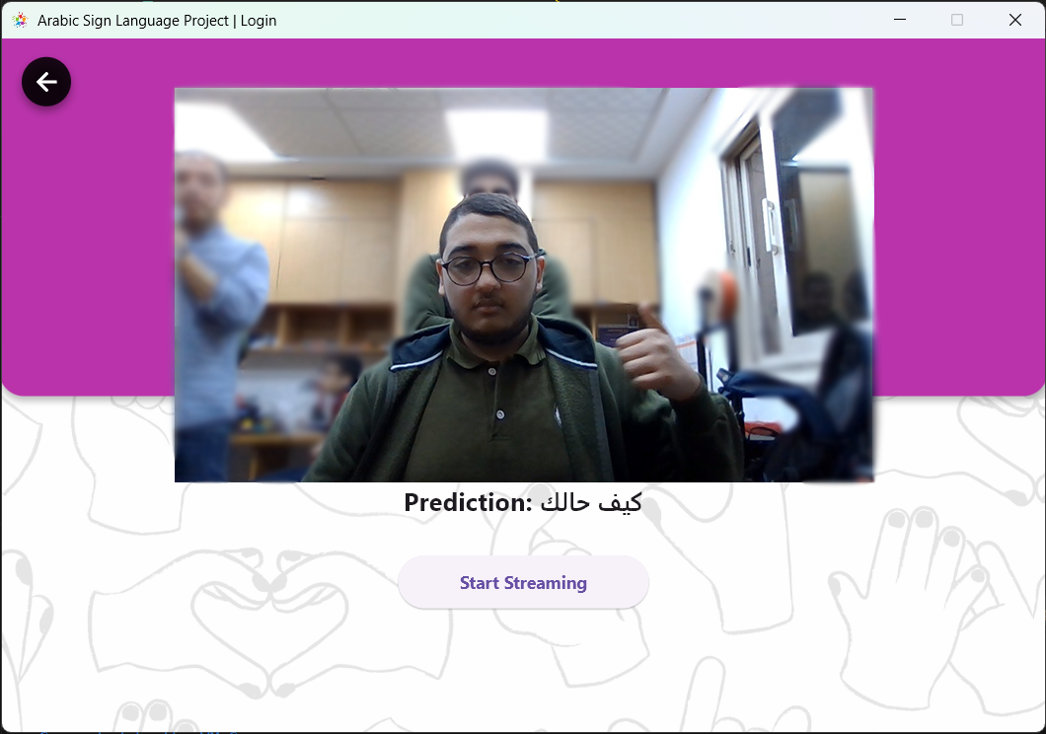
Overview of Sign Language to word

Slide 32
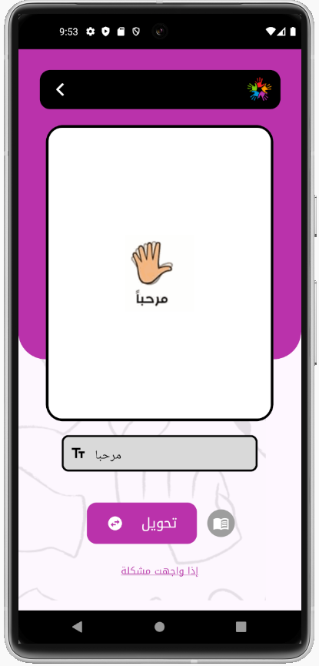
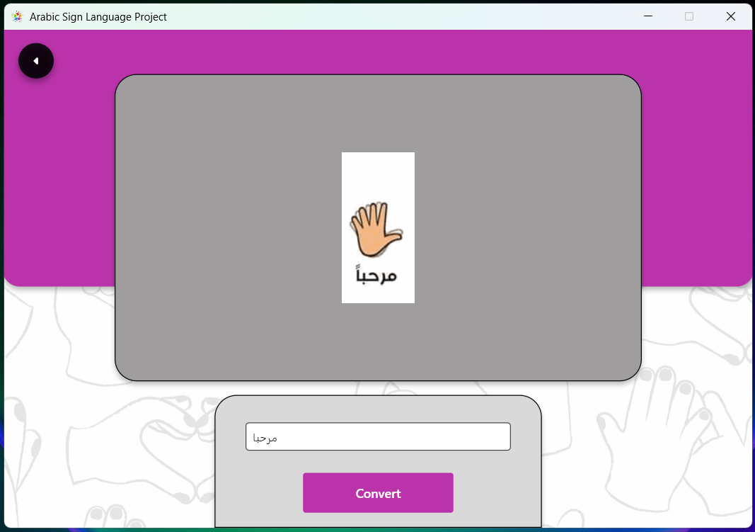
Overview of Text to Sign Language

Slide 33
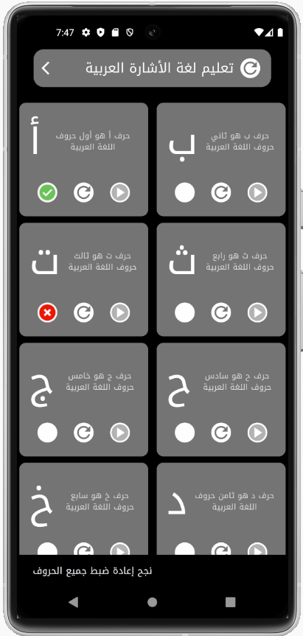
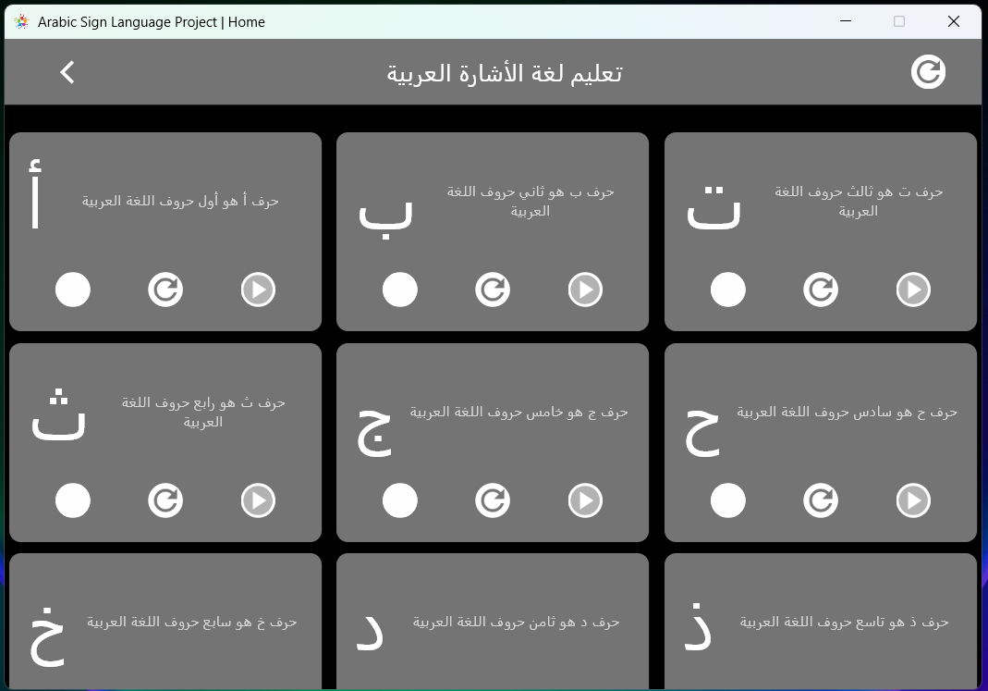
Overview of Learn Letters

Slide 34
How Flutter builds mobile and desktop apps
When creating a mobile app with Flutter, the Dart code is compiled into native code for Android (APK or AAB) or iOS (IPA), and it runs using Flutter’s rendering engine.
Developers can also access native features using platform channels that connect Dart with Kotlin or Swift.
For Windows applications, Flutter uses a similar approach.
The UI is built with the same Dart code, but the app runs with a native Windows runner written in C++.
It compiles into an executable (.exe) file using Visual Studio and communicates with Windows APIs as needed.

Slide 35
Key Points About the Application Purpose
Multi-Language Support : Supports Arabic and English , Language-specific text is managed in Language.dart.
Core Features :
Sign Language to Words : Converts gestures (images/videos) to text.
Words to Sign Language : Converts text to sign language (GIFs).
Learn Letters : Practice and learn sign language letters.
History : Tracks and displays user interactions.
Settings : Manages profile, language, and preferences.
Error Handling :
Feedback via Snack Bars and Dialogs.
Handles API errors and invalid user inputs.

Slide 36
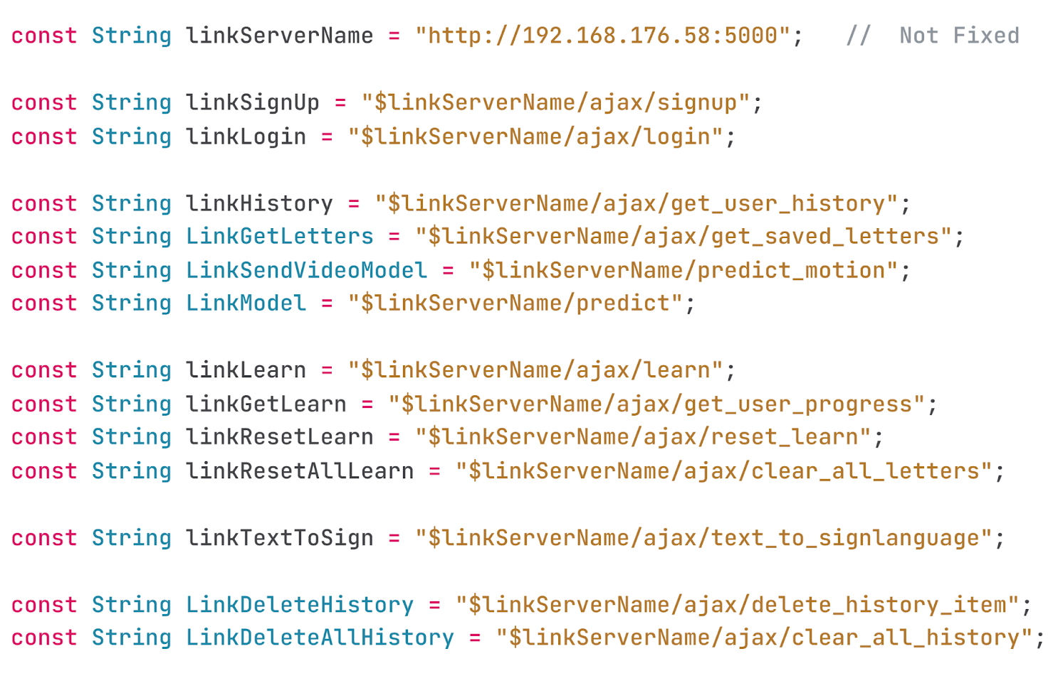
Page of all Links of project

Slide 37
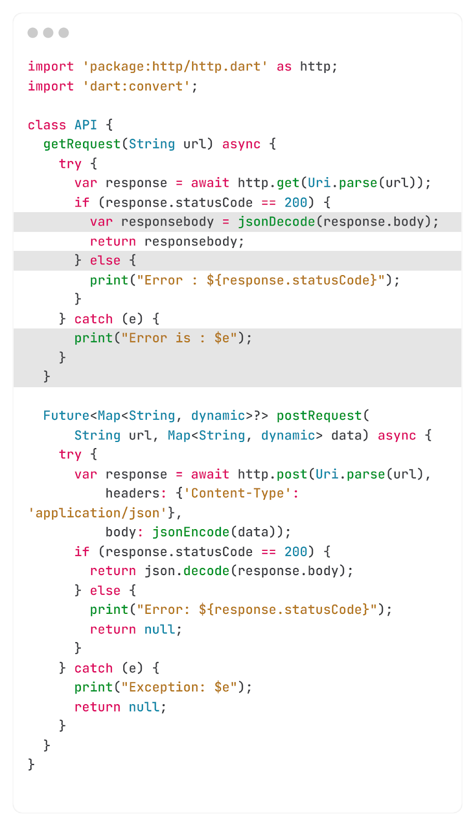
API Functions Template for Code Implementation
getRequest(): Retrieves data from an API endpoint. For example, to fetch sign language data for a word, provide the URL of the target page.
postRequest(): Sends data to an API endpoint for saving or processing. For instance, to submit login credentials, send a dictionary containing key-value pairs
along with the target URL.

Slide 38
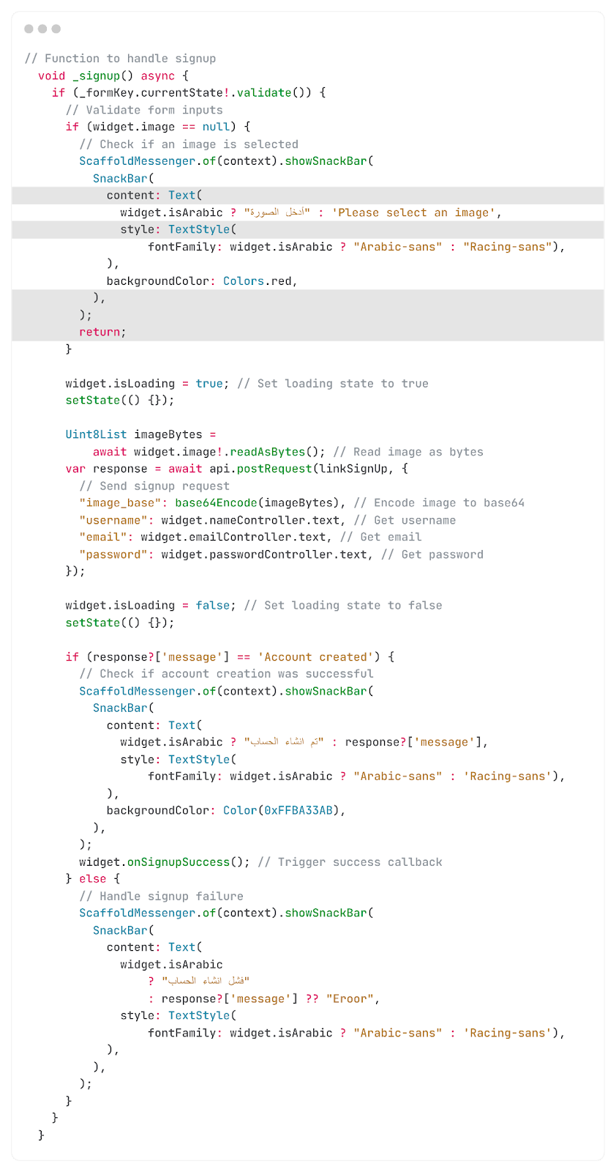
Signup Page Important sections
This function validates the inputs for name, profile picture, email, and password If any errors are detected,
an error message is returned. If all inputs are valid, the data is sent to the API, and the onSignupSuccess() function is triggered.

Slide 39
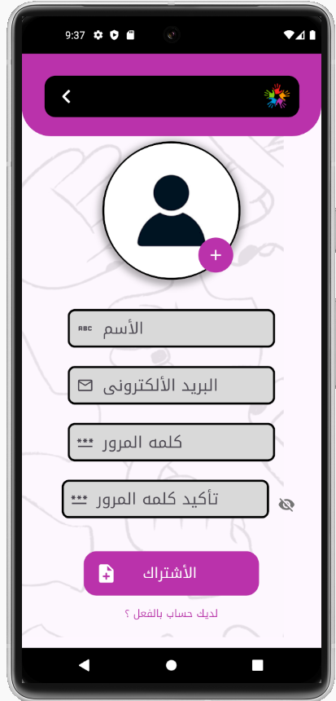
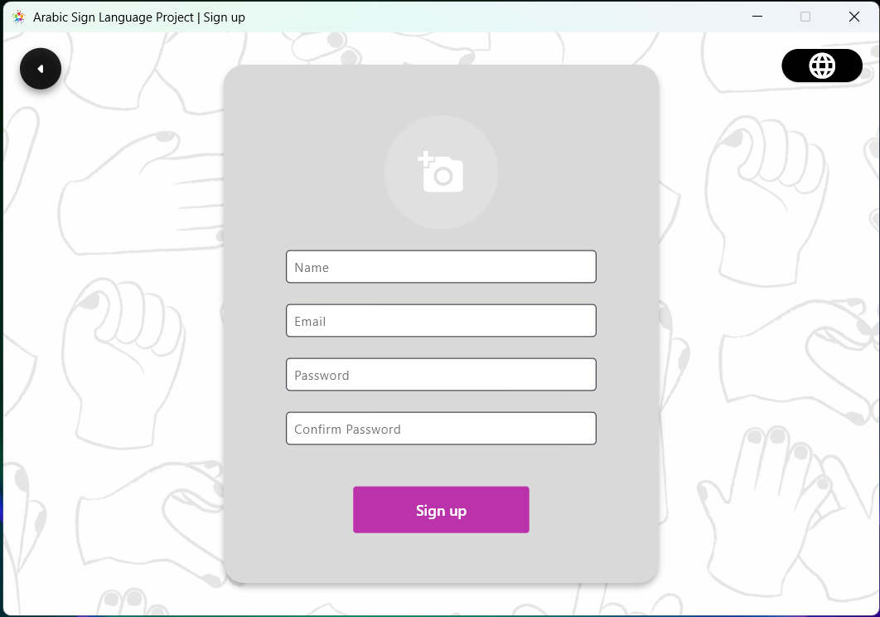
Overview of Signup Page

Slide 40
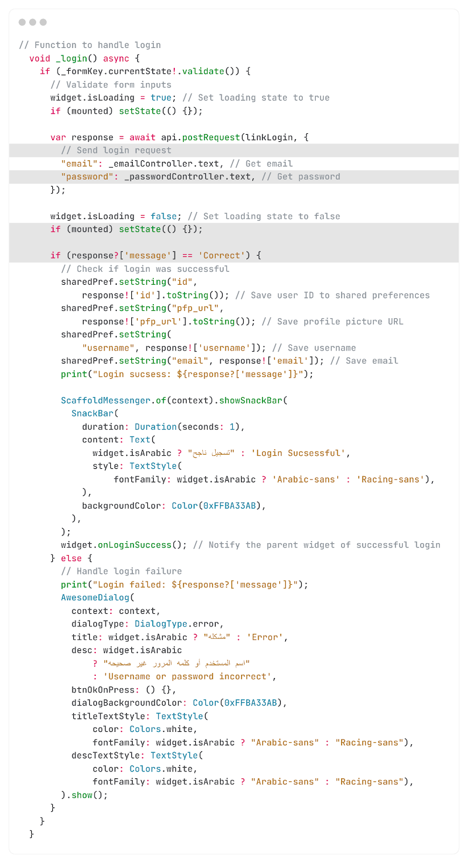
Login Page Important sections
This function takes an email and password as input, sends them to the API, and verifies the existence of the associated account. If found, the user's ID, profile image, email, and name are stored, the onLoginSuccess() function is triggered, and a “Login Success” message is displayed.
If the credentials are incorrect, the message
“Username or password incorrect” is shown.

Slide 41
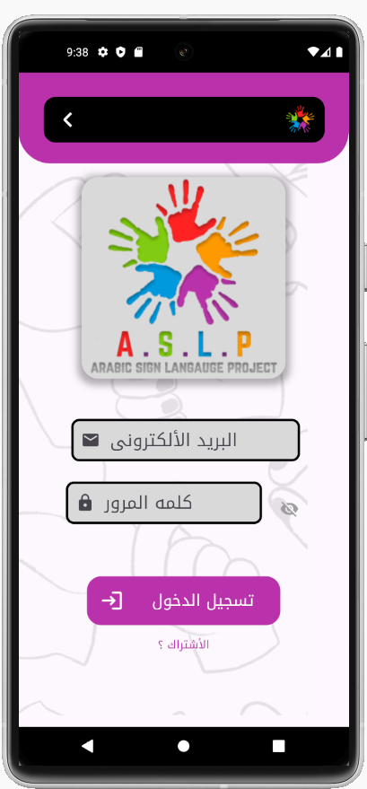
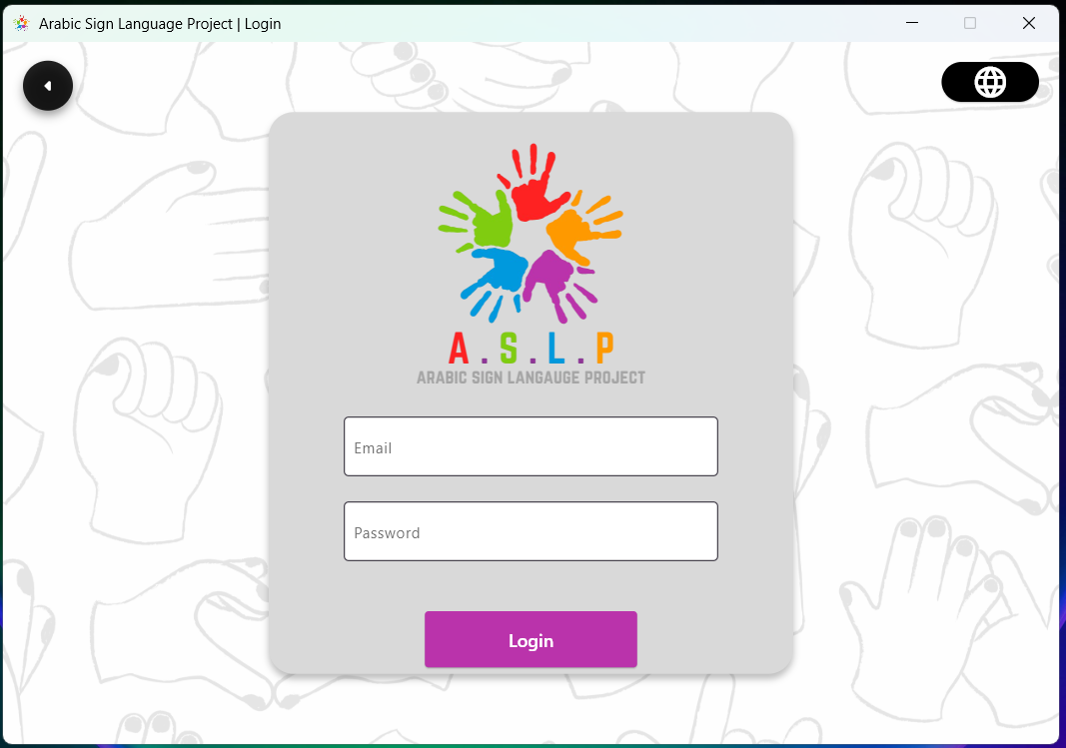
Overview of Login Page

Slide 42
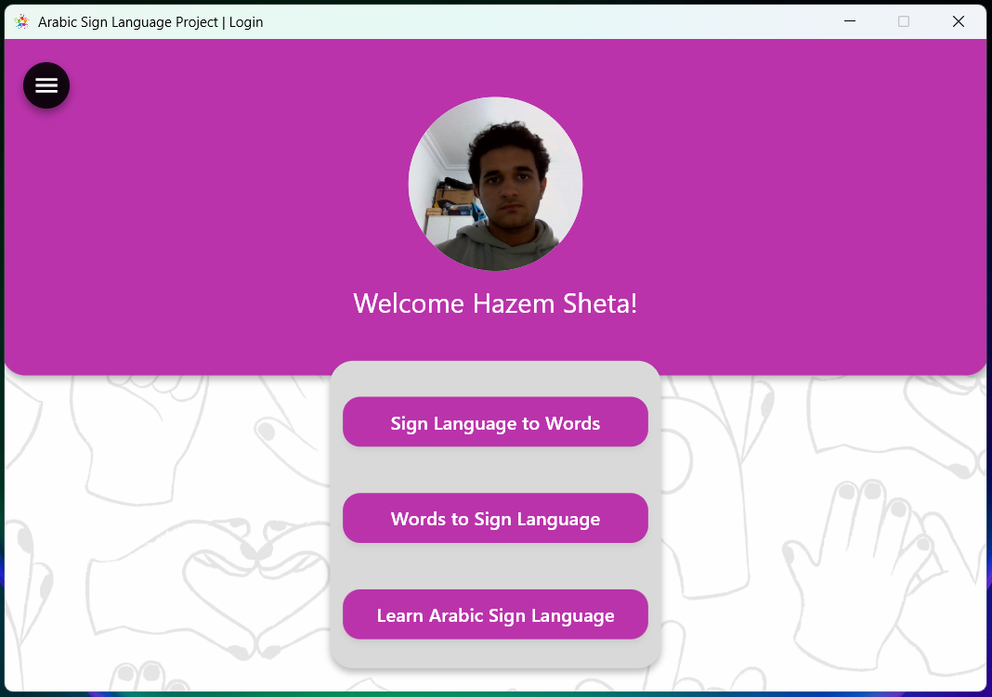
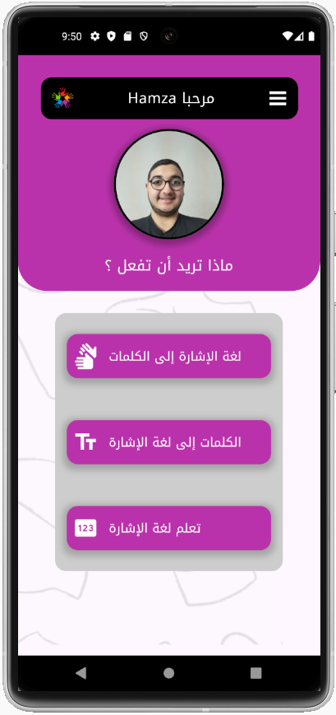
Overview of Home Page
After logging in, users land on the Home Screen with three main buttons:
Sign Language to Words – Users select a media type, access the camera, and send gestures to the API for translation.
Words to Sign Language – Users input text, which the API converts into an image or GIF.
Learn Arabic Sign Language – Users choose a letter to practice and improve their skills.

Slide 43
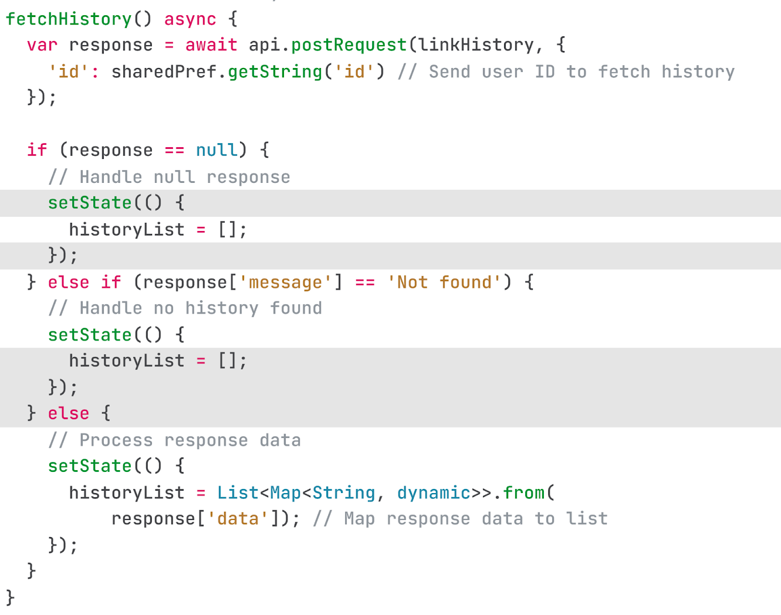
Important sections of history
This function retrieves and displays all history records from the API.
A User ID must be provided to fetch the corresponding data.

Slide 44
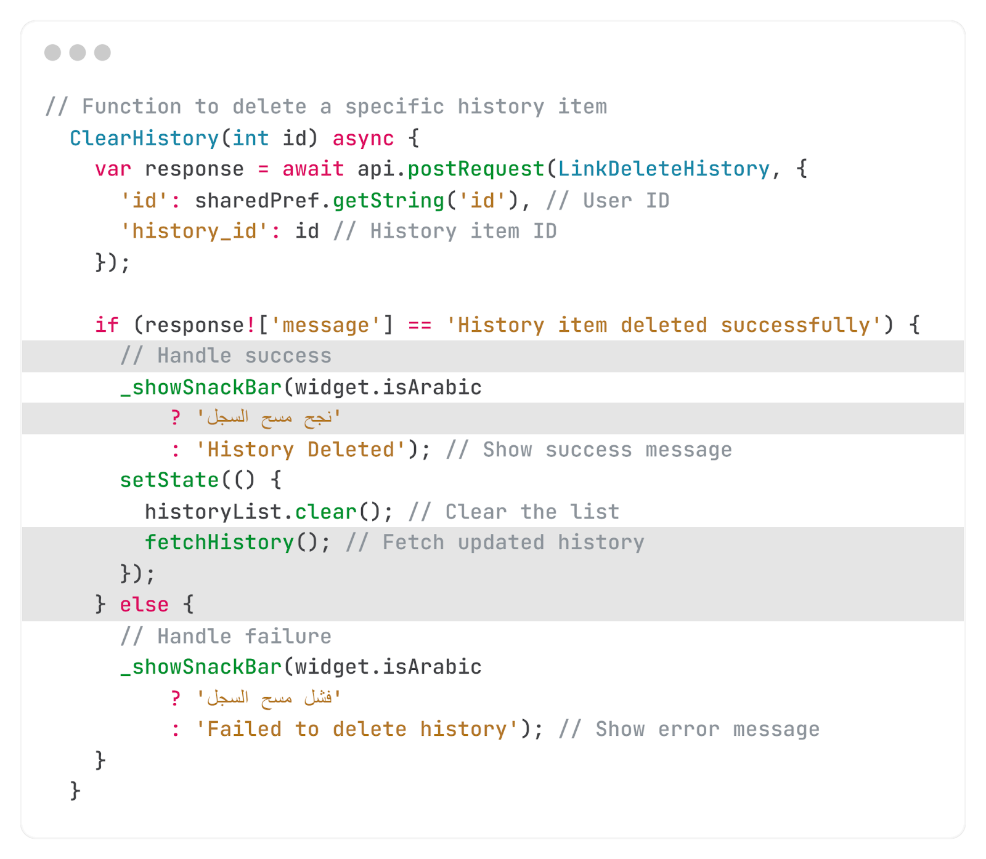
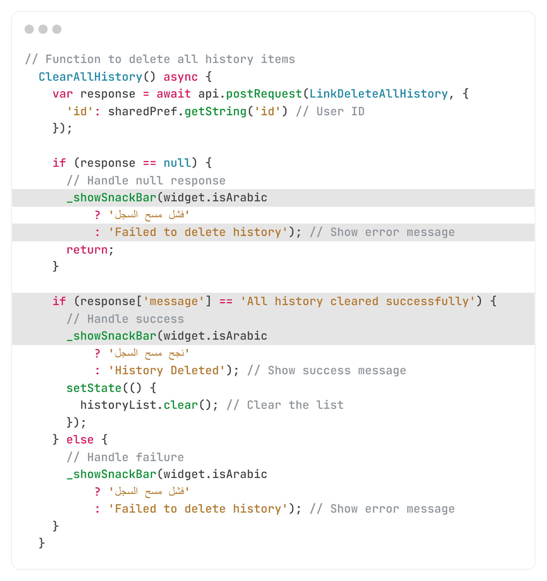
Important sections of history
This function deletes a specific history record from the API.
While the other deletes all history.
To proceed with the deletion, both the User ID and History ID must be provided.

Slide 45
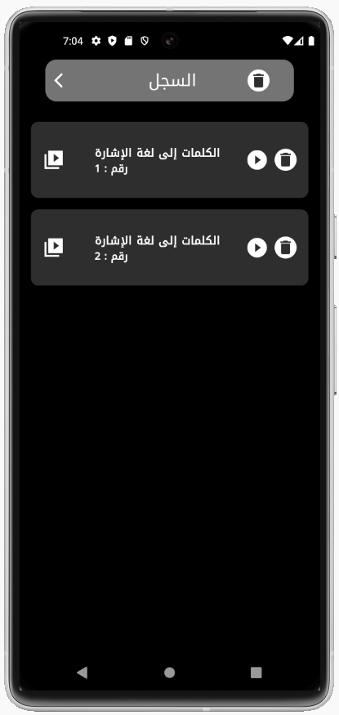
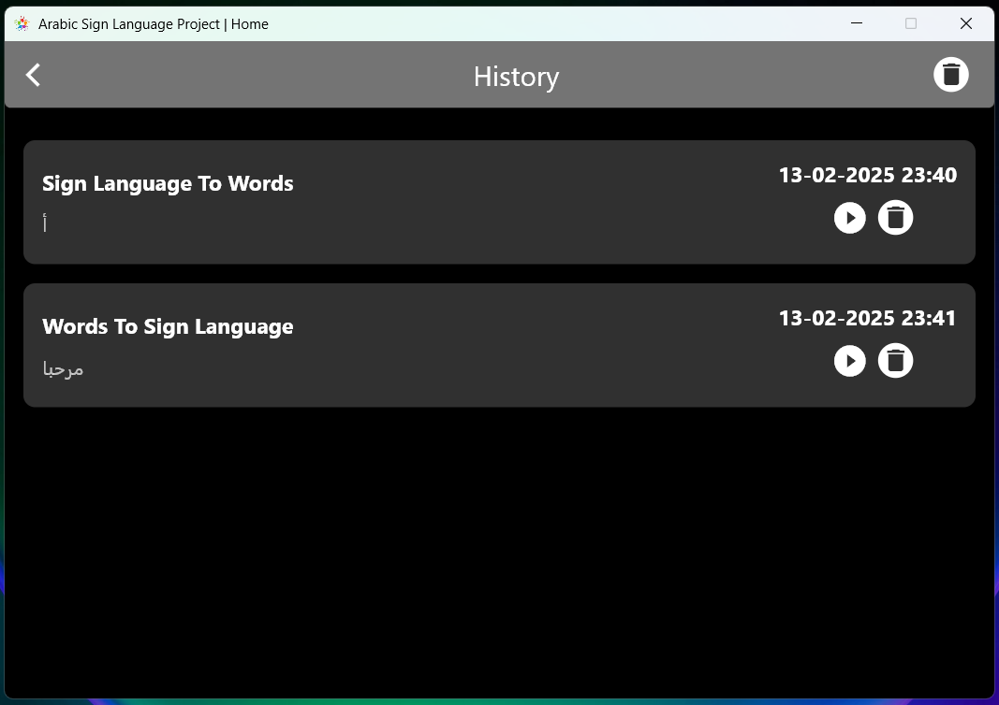
Overview of History

Slide 46
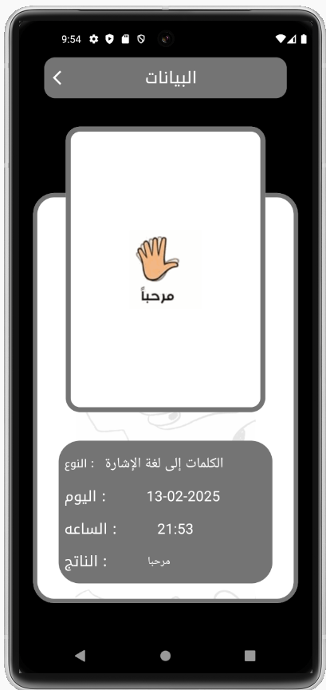
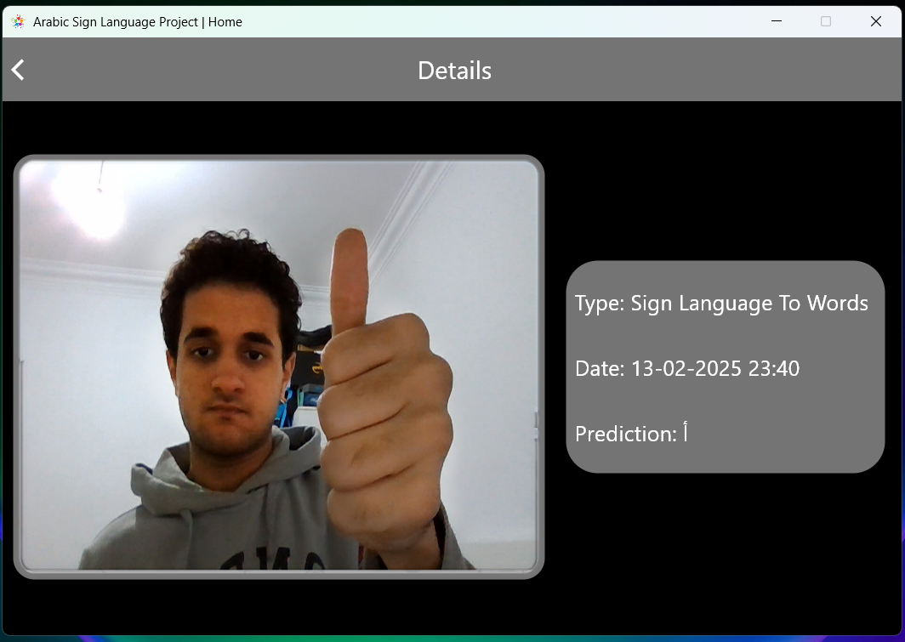
Overview of History

Slide 47
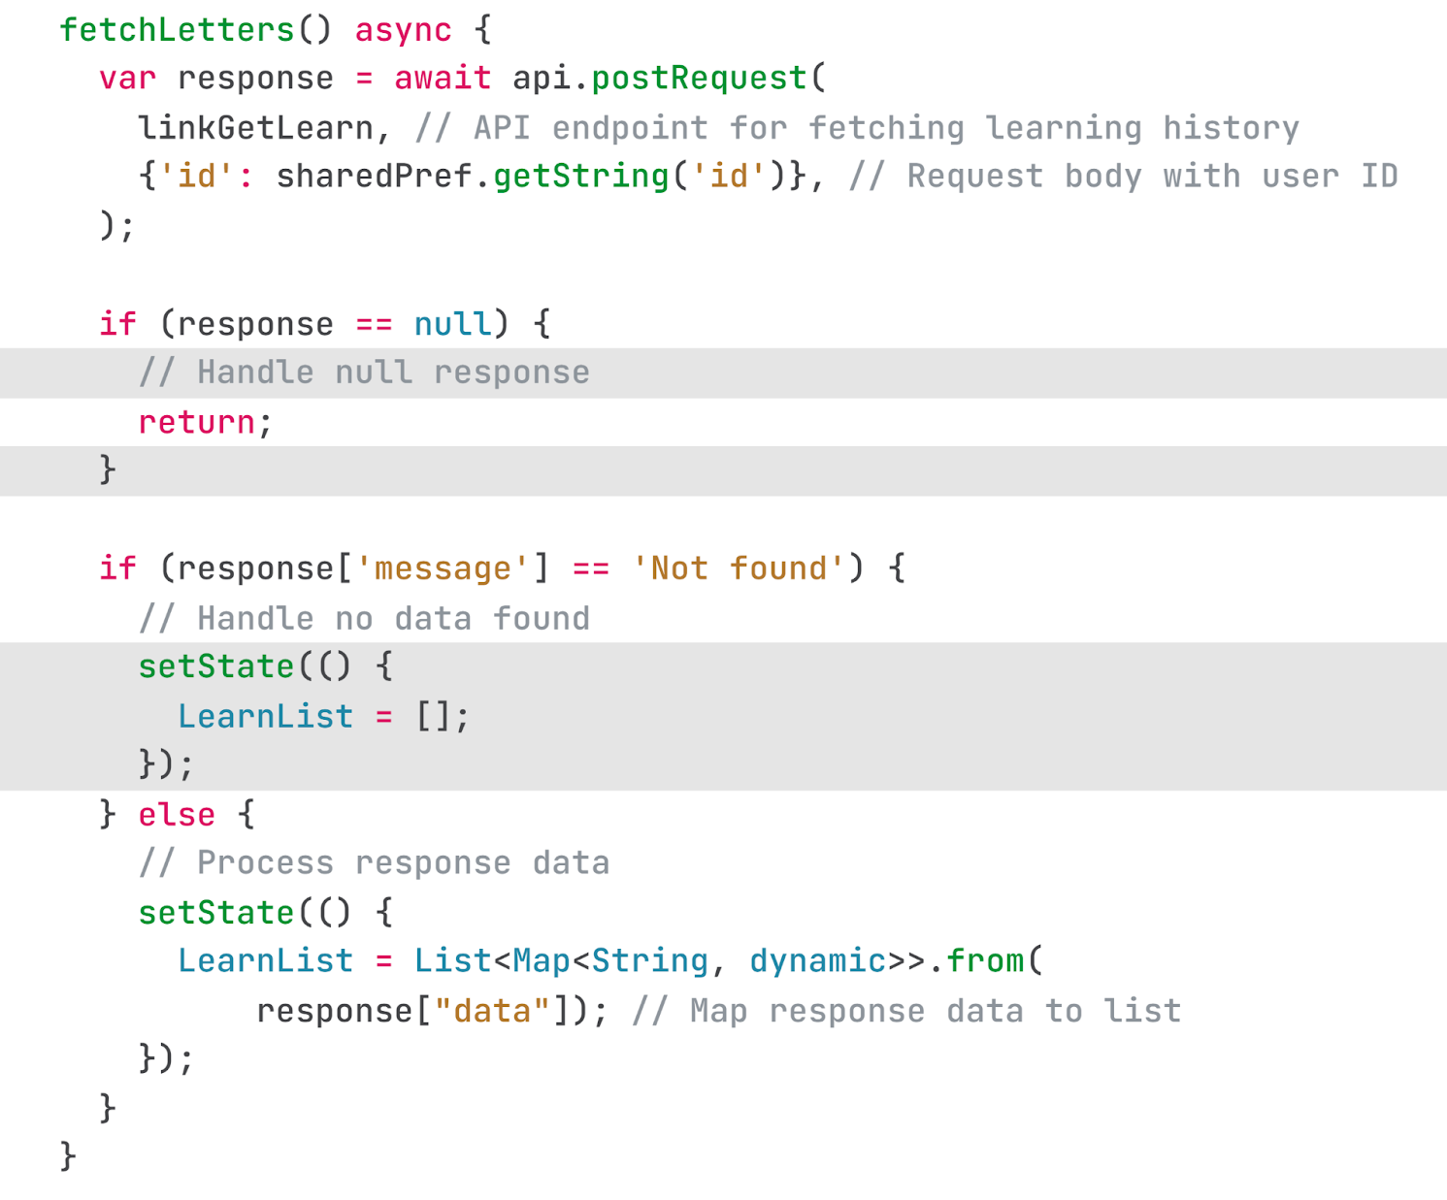
Important sections of Learn Letter
This function displays all letters for learning, indicating which ones have been completed and which are still pending.
It also provides a relearn button for any letter as well as an option to relearn all letter

Slide 48
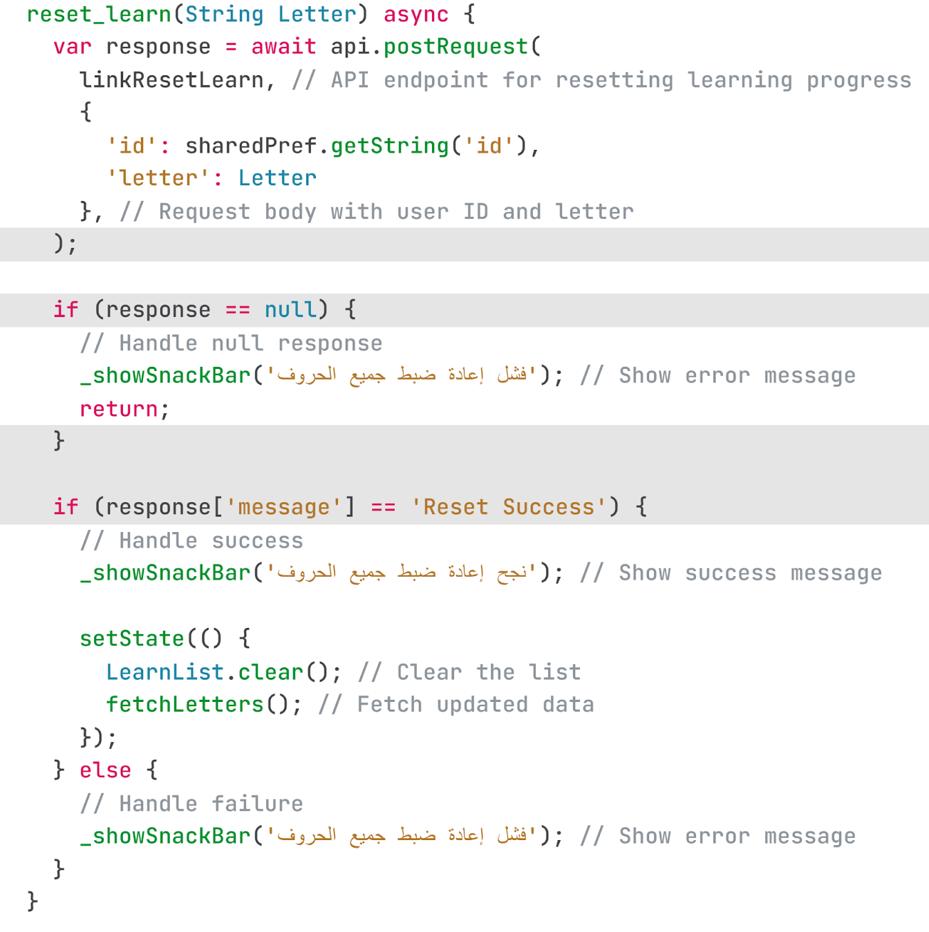
Important sections of Learn Letter
This function allows relearning of a specific character from the set of learning characters.
To proceed, the User ID and the desired character must be provided

Slide 49
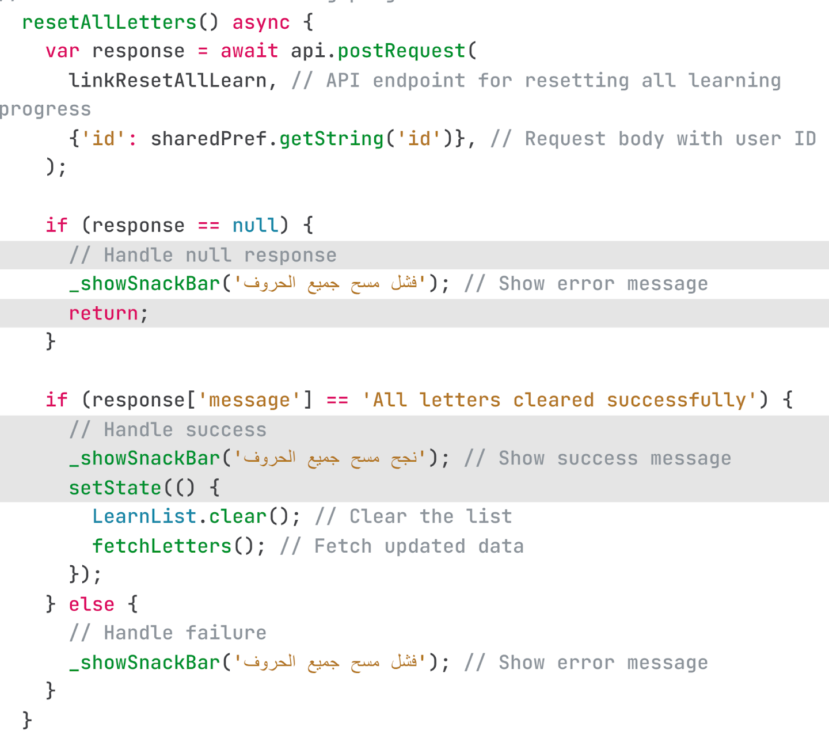
Important sections of Learn Letter
This function enables the relearning of all learning characters.
To initiate the process, the User ID must be provided,
and all characters will be reset for relearning

Slide 50
Overview of Learn Letters

Slide 51
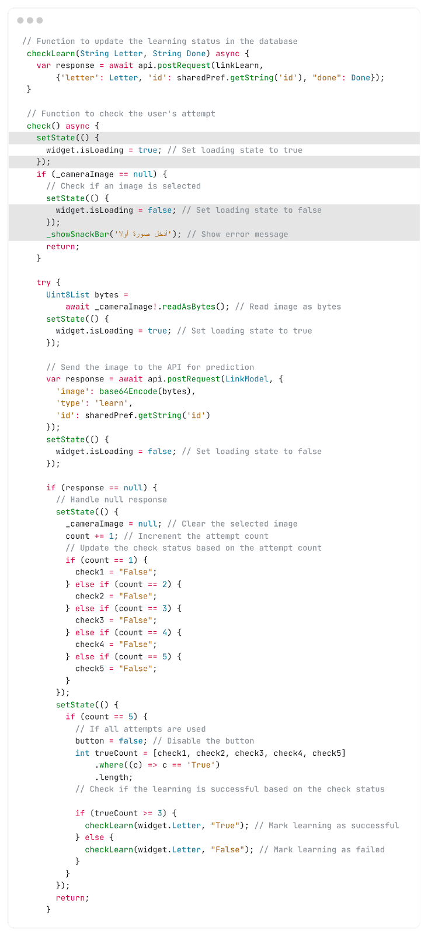
Important sections of Learning Checker
In this process, letters are learned by capturing images and performing hand gestures to form each letter.
If the user correctly performs the letter 3, 4, or 5 times, it is considered learned. However, if the user fails to perform the letter correctly within those attempts, it remains unlearned.
Exiting before completing all 5 attempts also results in the letter
being unlearned .
The final results are recorded, and the status of each letter is displayed, indicating whether it has been successfully learned or not

Slide 52
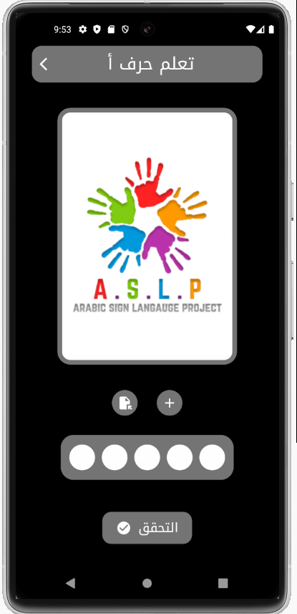
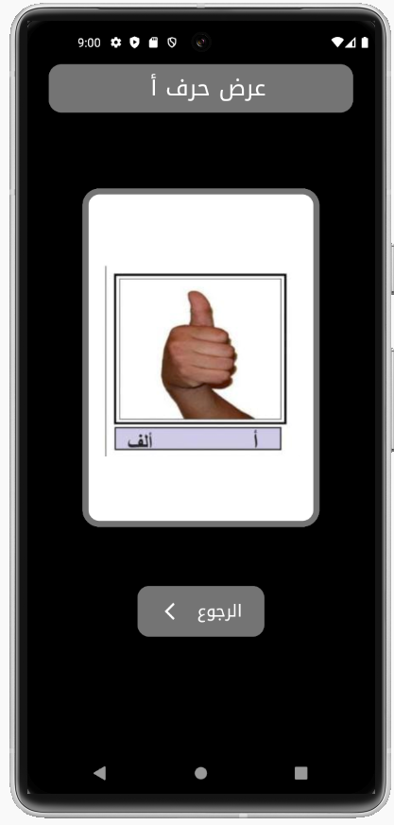
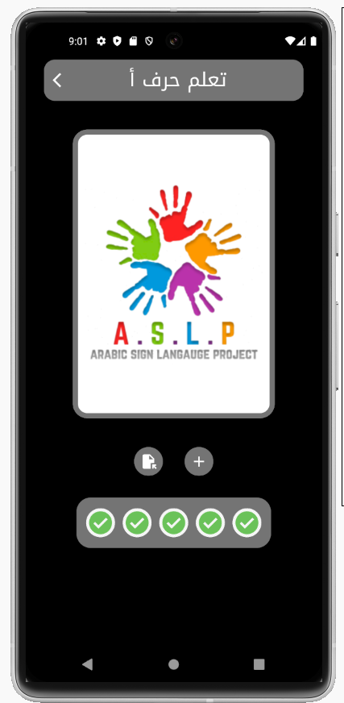
Overview of Learning Page

Slide 53
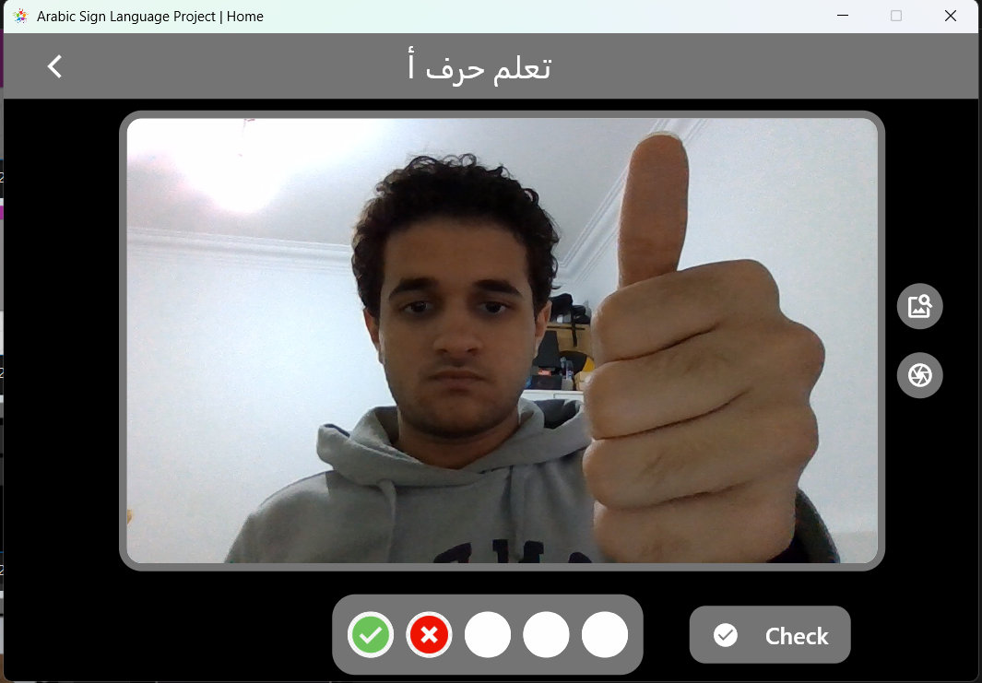
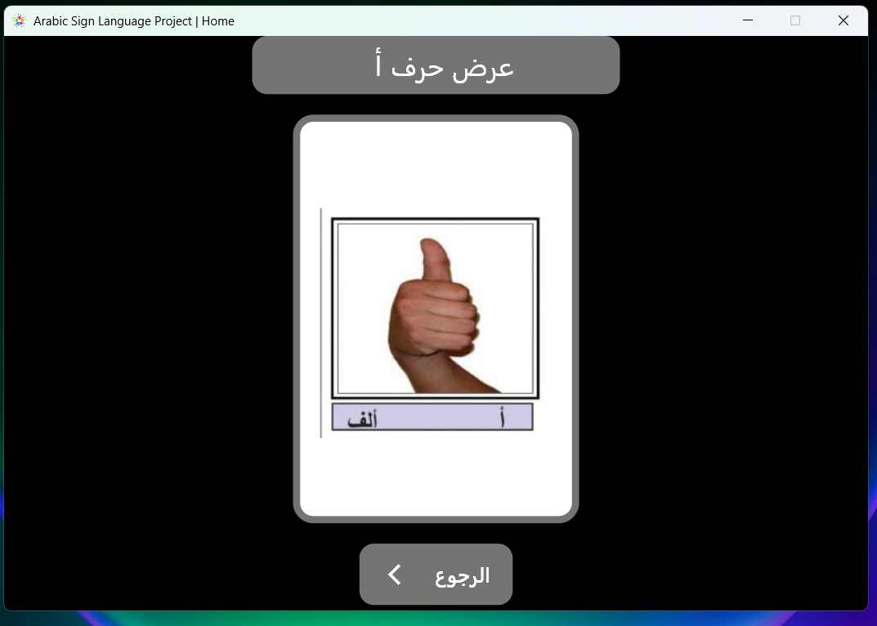
Overview of Learning Page

Slide 54
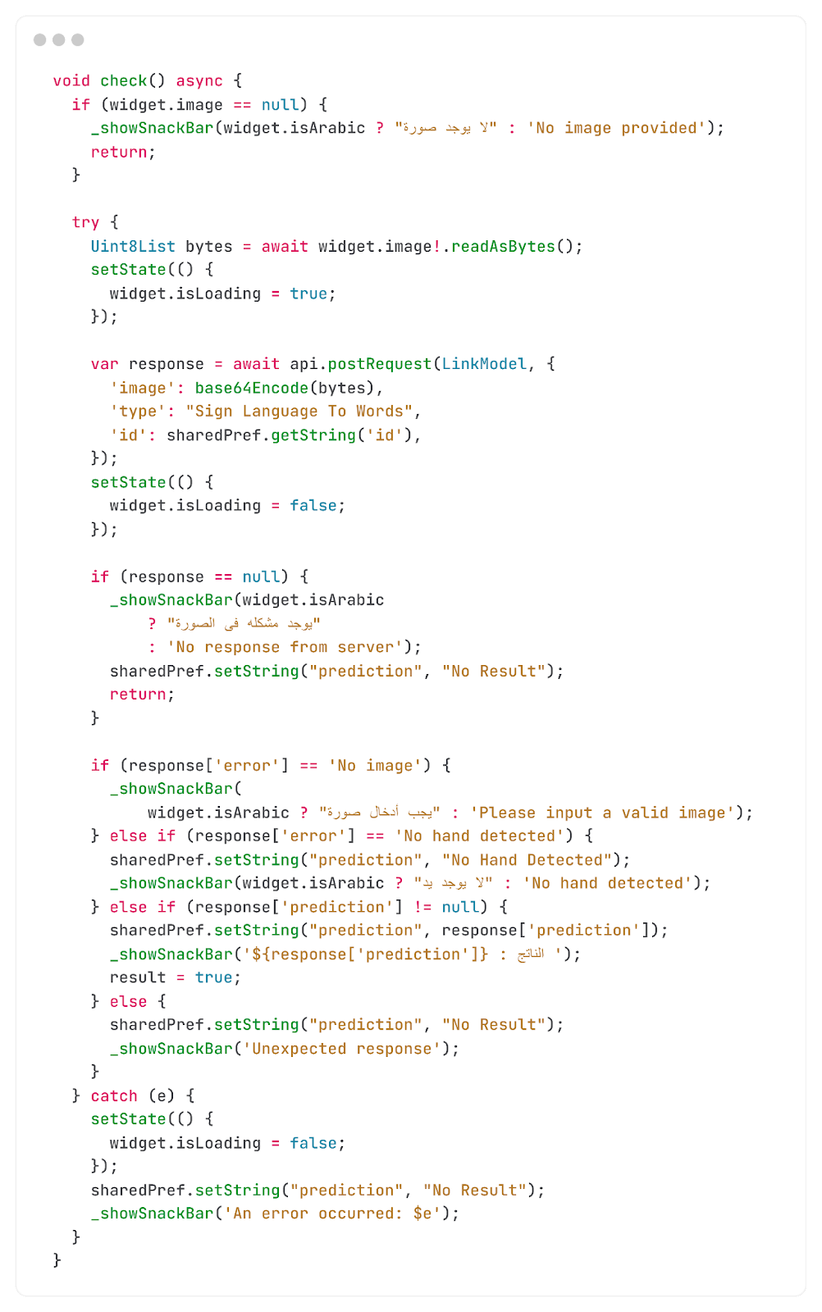
Important sections of SL to Word
This page enables the conversion of sign language or gestures into a specific letter. The process can be carried out by either selecting an image from the device or capturing one using the camera.

Slide 55
Overview of Sign Language to word

Slide 56
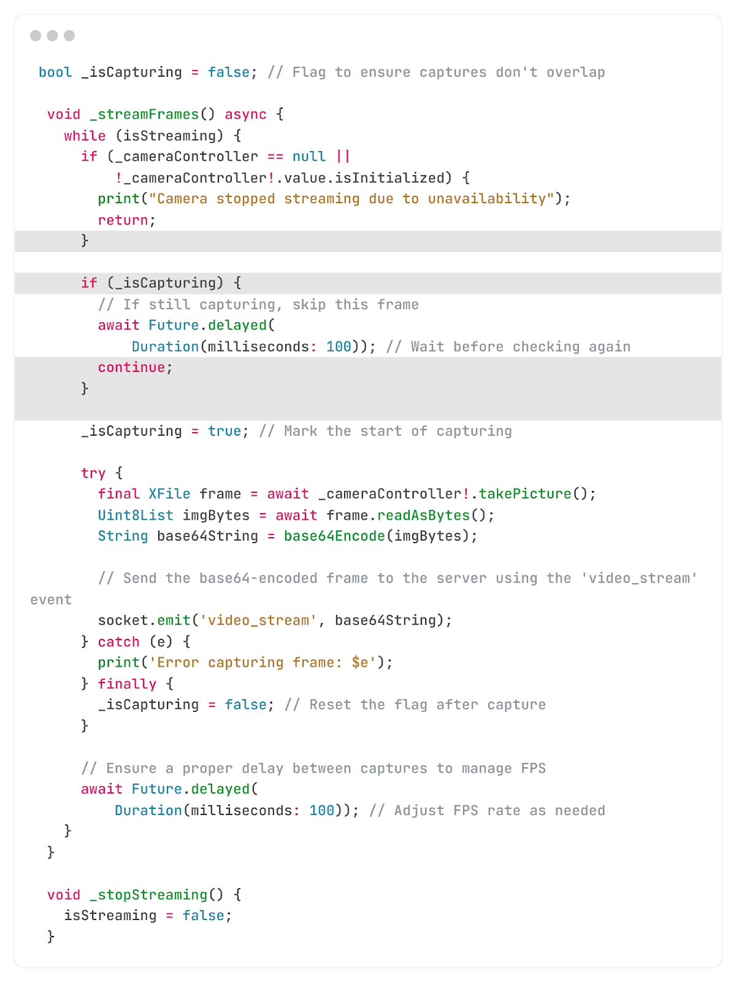
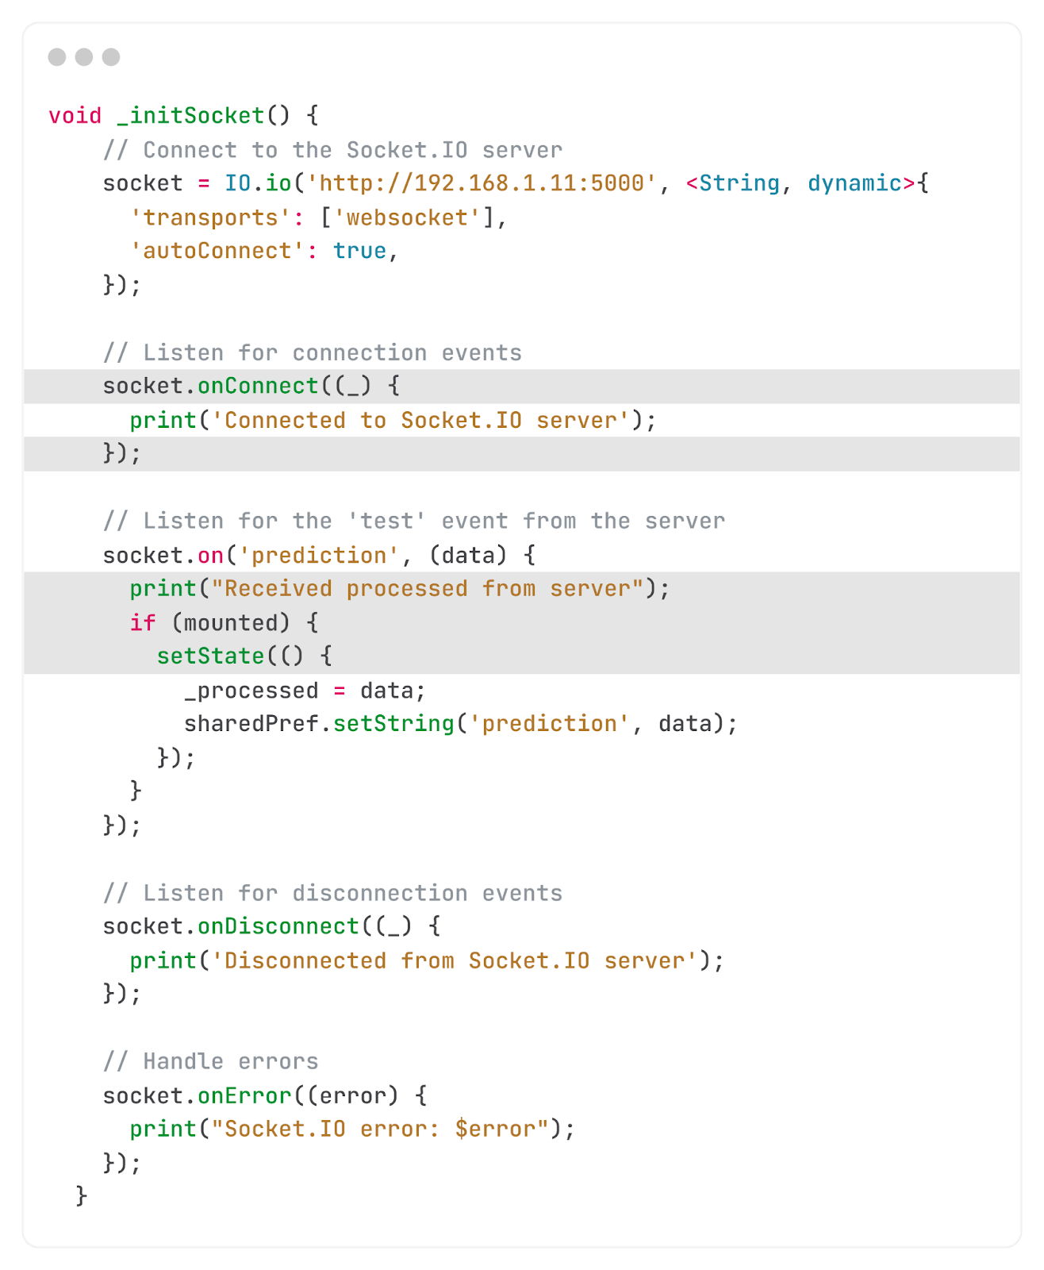
Important sections of Sign Language to word
In this function, a live stream is opened with the model to process the movements and gestures using a web Socket IO server.

Slide 57
Overview of Sign Language to word

Slide 58

Important sections of Text to Sign Language
This function processes a given word or sentence by retrieving and displaying corresponding word images as a video or GIF.
To perform the translation, the User ID and the desired word(s) must be sent to the API.
All actions are recorded in the history.

Slide 59
Overview of Text to Sign Language

Slide 60



Change Language
Pressing this button changes the language of the program between Arabic and English, and this is because the program is dedicated to Arabs, so the main language is Arabic and English because it is the language of the world

Slide 61



Important sections of Text to Sign Language
Clicking this button re-directs you to a webpage that provides a detailed overview of the project, including its objectives, the team behind it, and its timeline
https://sites.google.com/view/aslp-info/home

Slide 62
Future Work
To enhance our system, future work could focus on:
Expanding the Training Dataset: Collecting and labeling more Arabic sign gestures to improve accuracy.
Integrating NLP: Using natural language processing to improve contextual understanding.
Web Implementation: Developing a web-based solution for broader accessibility.
Improving the Live option: Current applications rely on cloud processing, requiring users to upload videos or images for translation, and a working live option that needs to be improved and worked on, reducing delays and enhancing user experience.

Slide 63
Conclusion
Our project marks a significant step in bridging the communication gap for the Arabic-speaking deaf community. With further development, this translator could become an essential tool in improving accessibility and inclusion across various sectors.

Slide 64


Photos of our project presentation at Edu Tech Exhibition

Slide 65

Photos from our project presentation at the Egyptian Robotics League

Slide 66
Thank You
Under Supervision Of
Dr. Michael Nasif
Eng. Hassan Talal

Slide 67

Special thanks to
Mr. Ahmed Hamdy
نسألكم الدعاء له بالرحمة والمغفرة

